Slide 1
MISP in SRH in post disaster situation
Kalyani Raj
Member In Charge
All India Women’s Conference

Slide 2
What is MISP
Minimum : basic, limited reproductive health
Initial : for use in emergency without site specific
need assessment
Service : services to be delivered to the women in
displaced population
Package : Supplies & activities, co-ordination and
planning

Slide 3
Goal of MISP
To increase access to SRH information and services for population displaced by disaster – man-made or natural
through :
Capacity building
Strengthening the co-ordination of SRH response measures &
Raise awareness on SRH in disaster; leading to
Effective and timely response to SRH needs in disaster

Slide 4
Module of MISP
A joint initiative of National Disaster Management Authority of India and UNFPA to achieve its goal through :
Increasing state and district capacity to implement the MISP
Strengthening coordination of SRH stakeholders and activities
Responding in a timely and effective manner to SRH needs
*

Slide 5
Uniqueness of MISP
First national initiative to address SRH in disaster through
capacity building
Integrating MISP in State & district disaster and health plans
Inter-agency collaborative approach
Bridging the gap between immediate relief & development
A comprehensive SRH package designed by policy makers,
& UN agency, implemented through CSOs
*

Slide 6
Topics covered under MISP
Overview of SRH in disaster
Institutional & Co-ordination mechanism
Sexual and Gender based violence
Maternal and new born health
SRH supplies and logistics
Monitoring and action planning
*

Slide 7
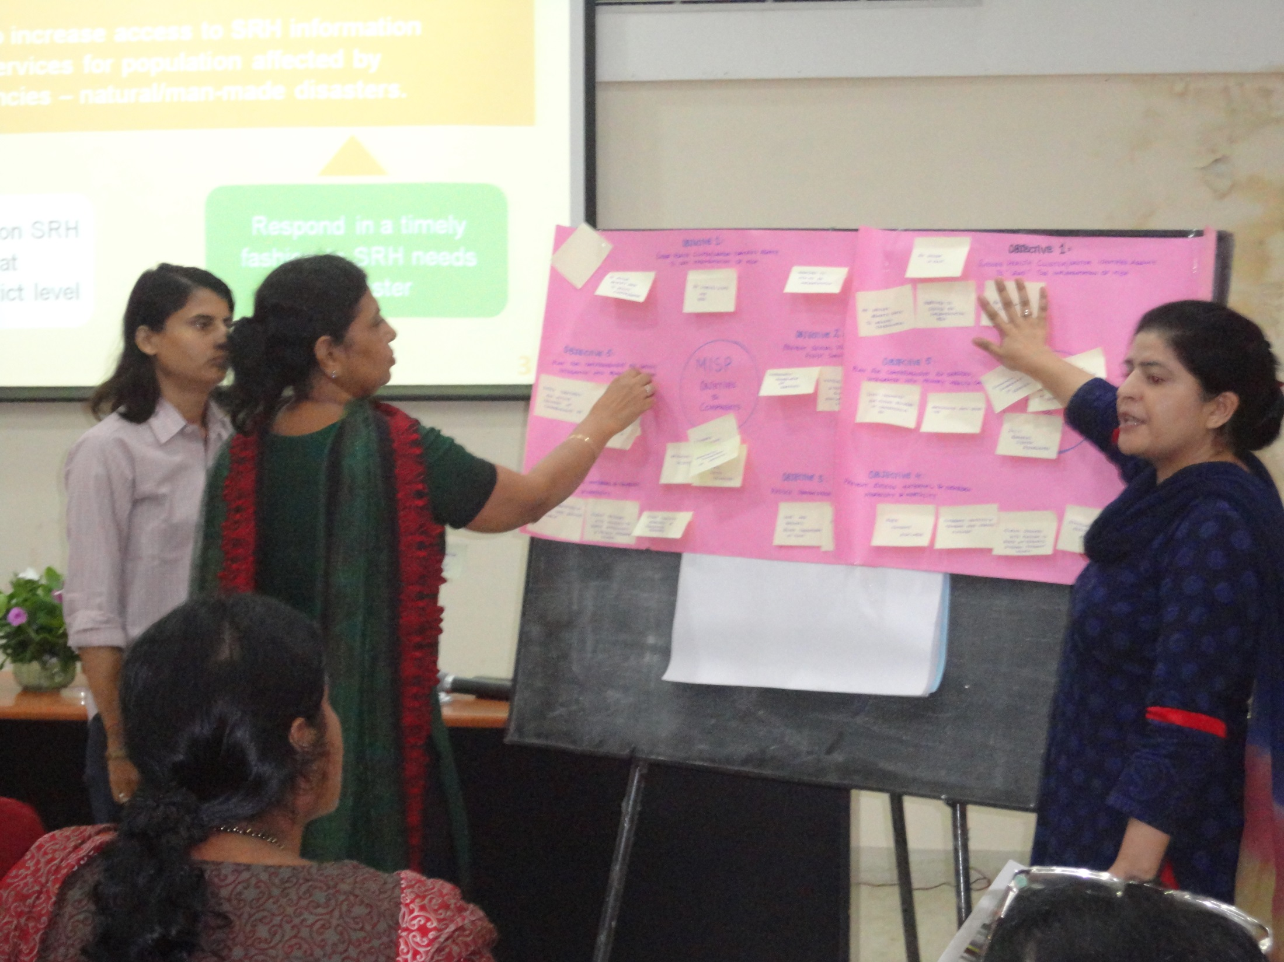

Slide 8
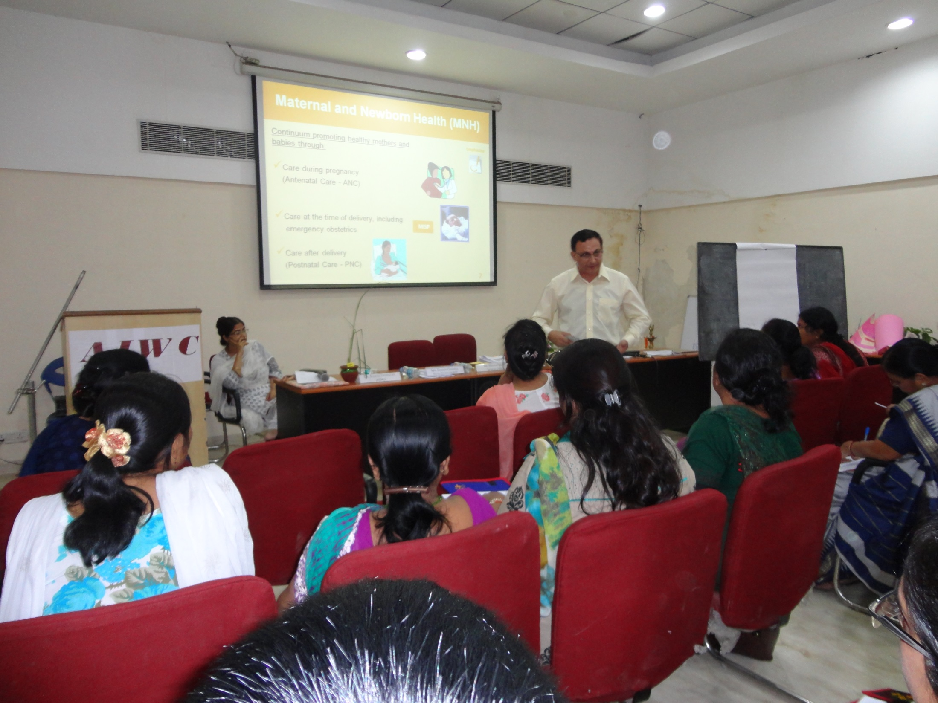

Slide 9
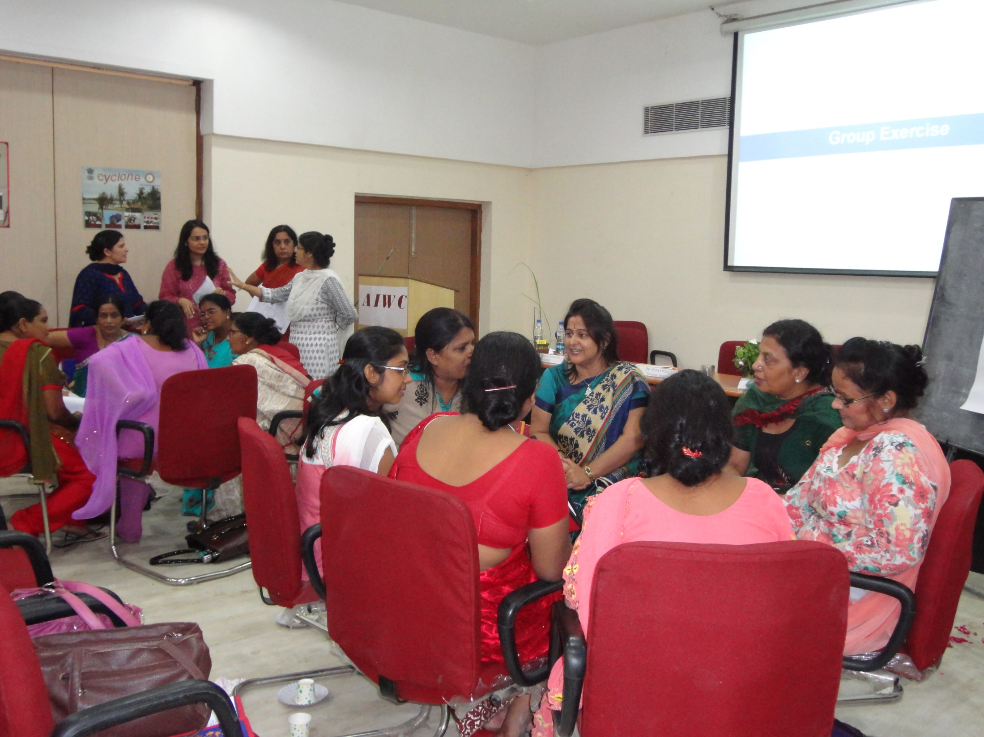

Slide 10
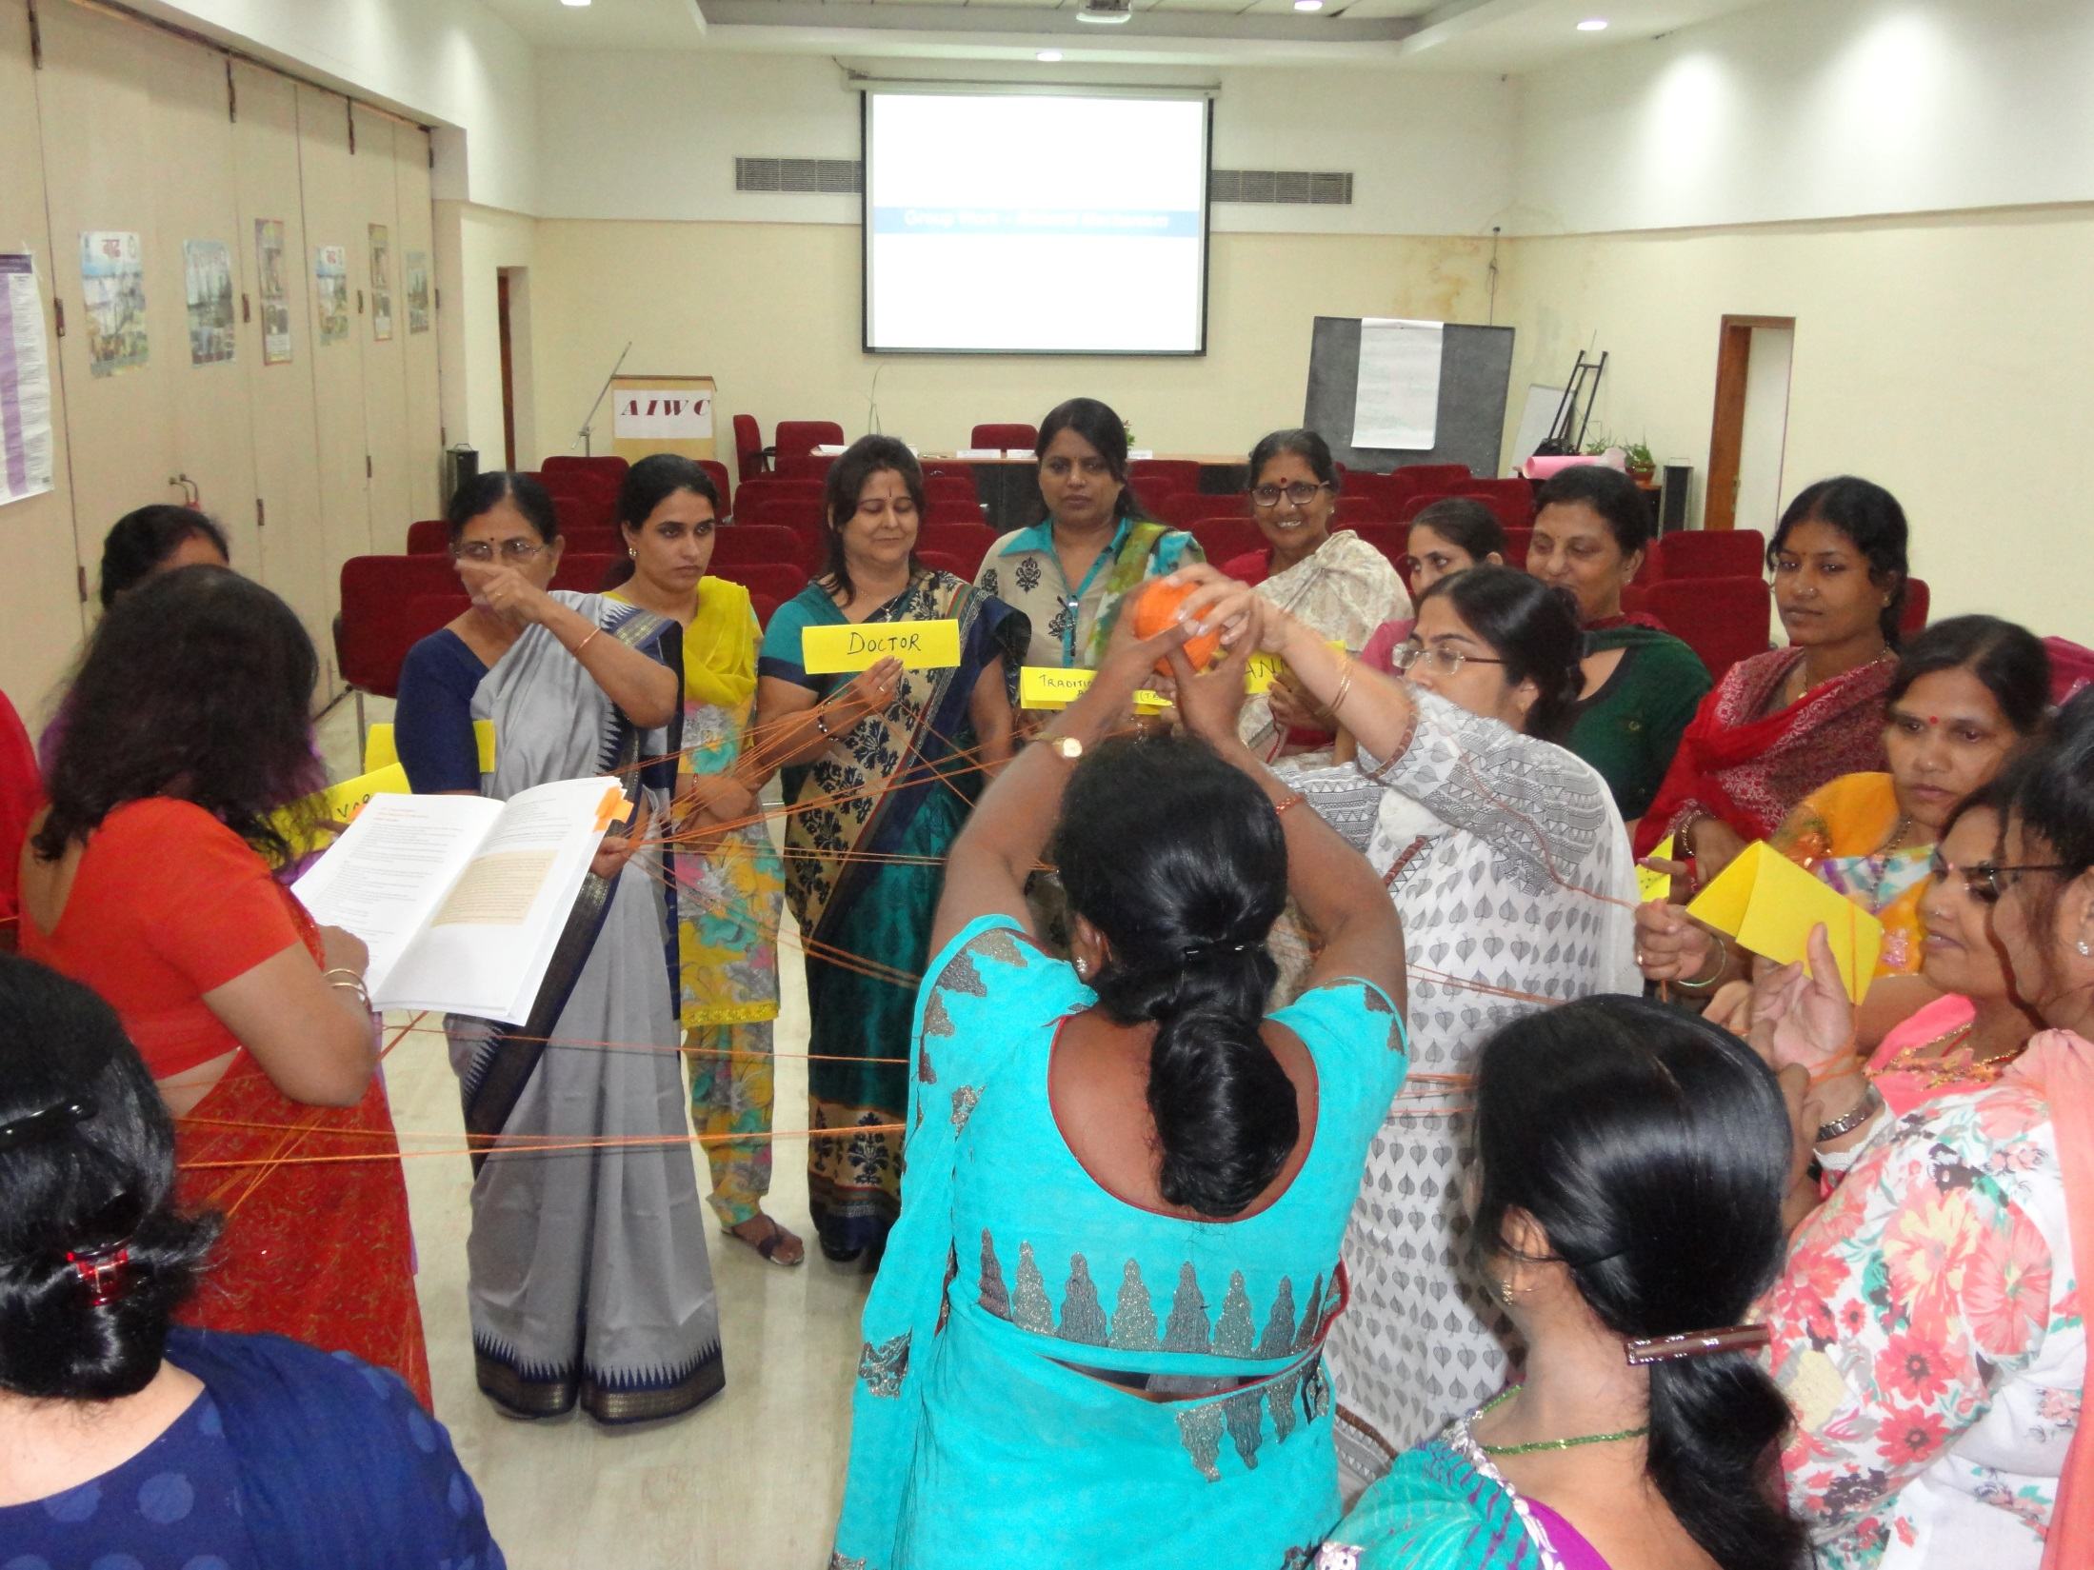

Slide 11
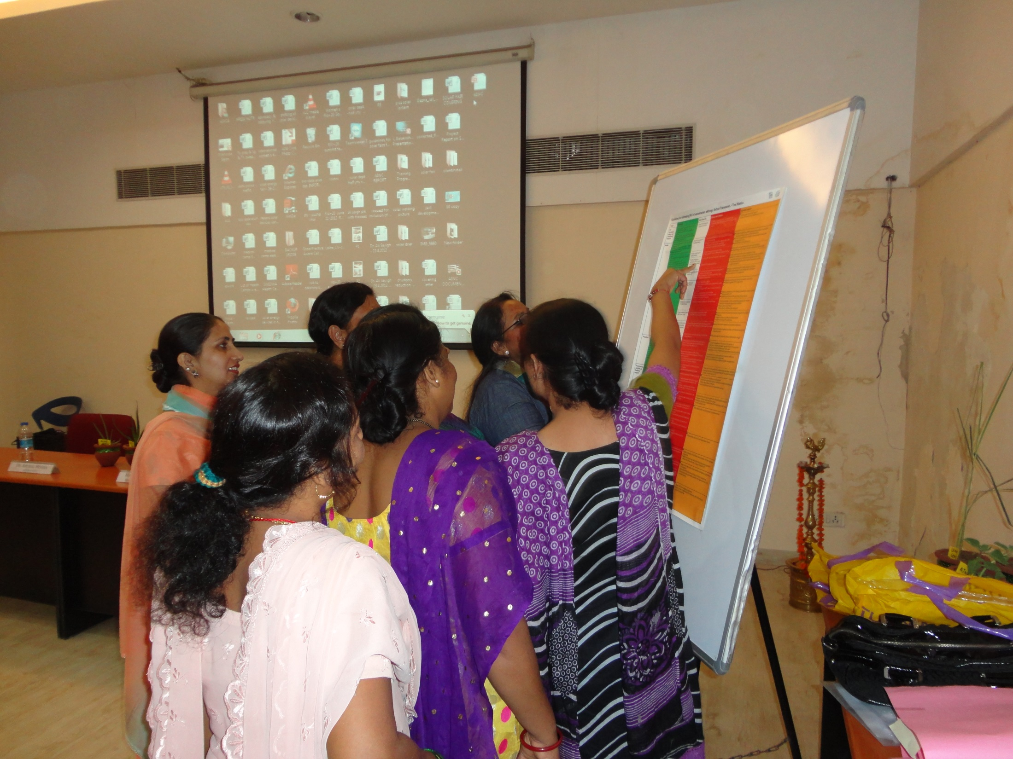

Slide 12
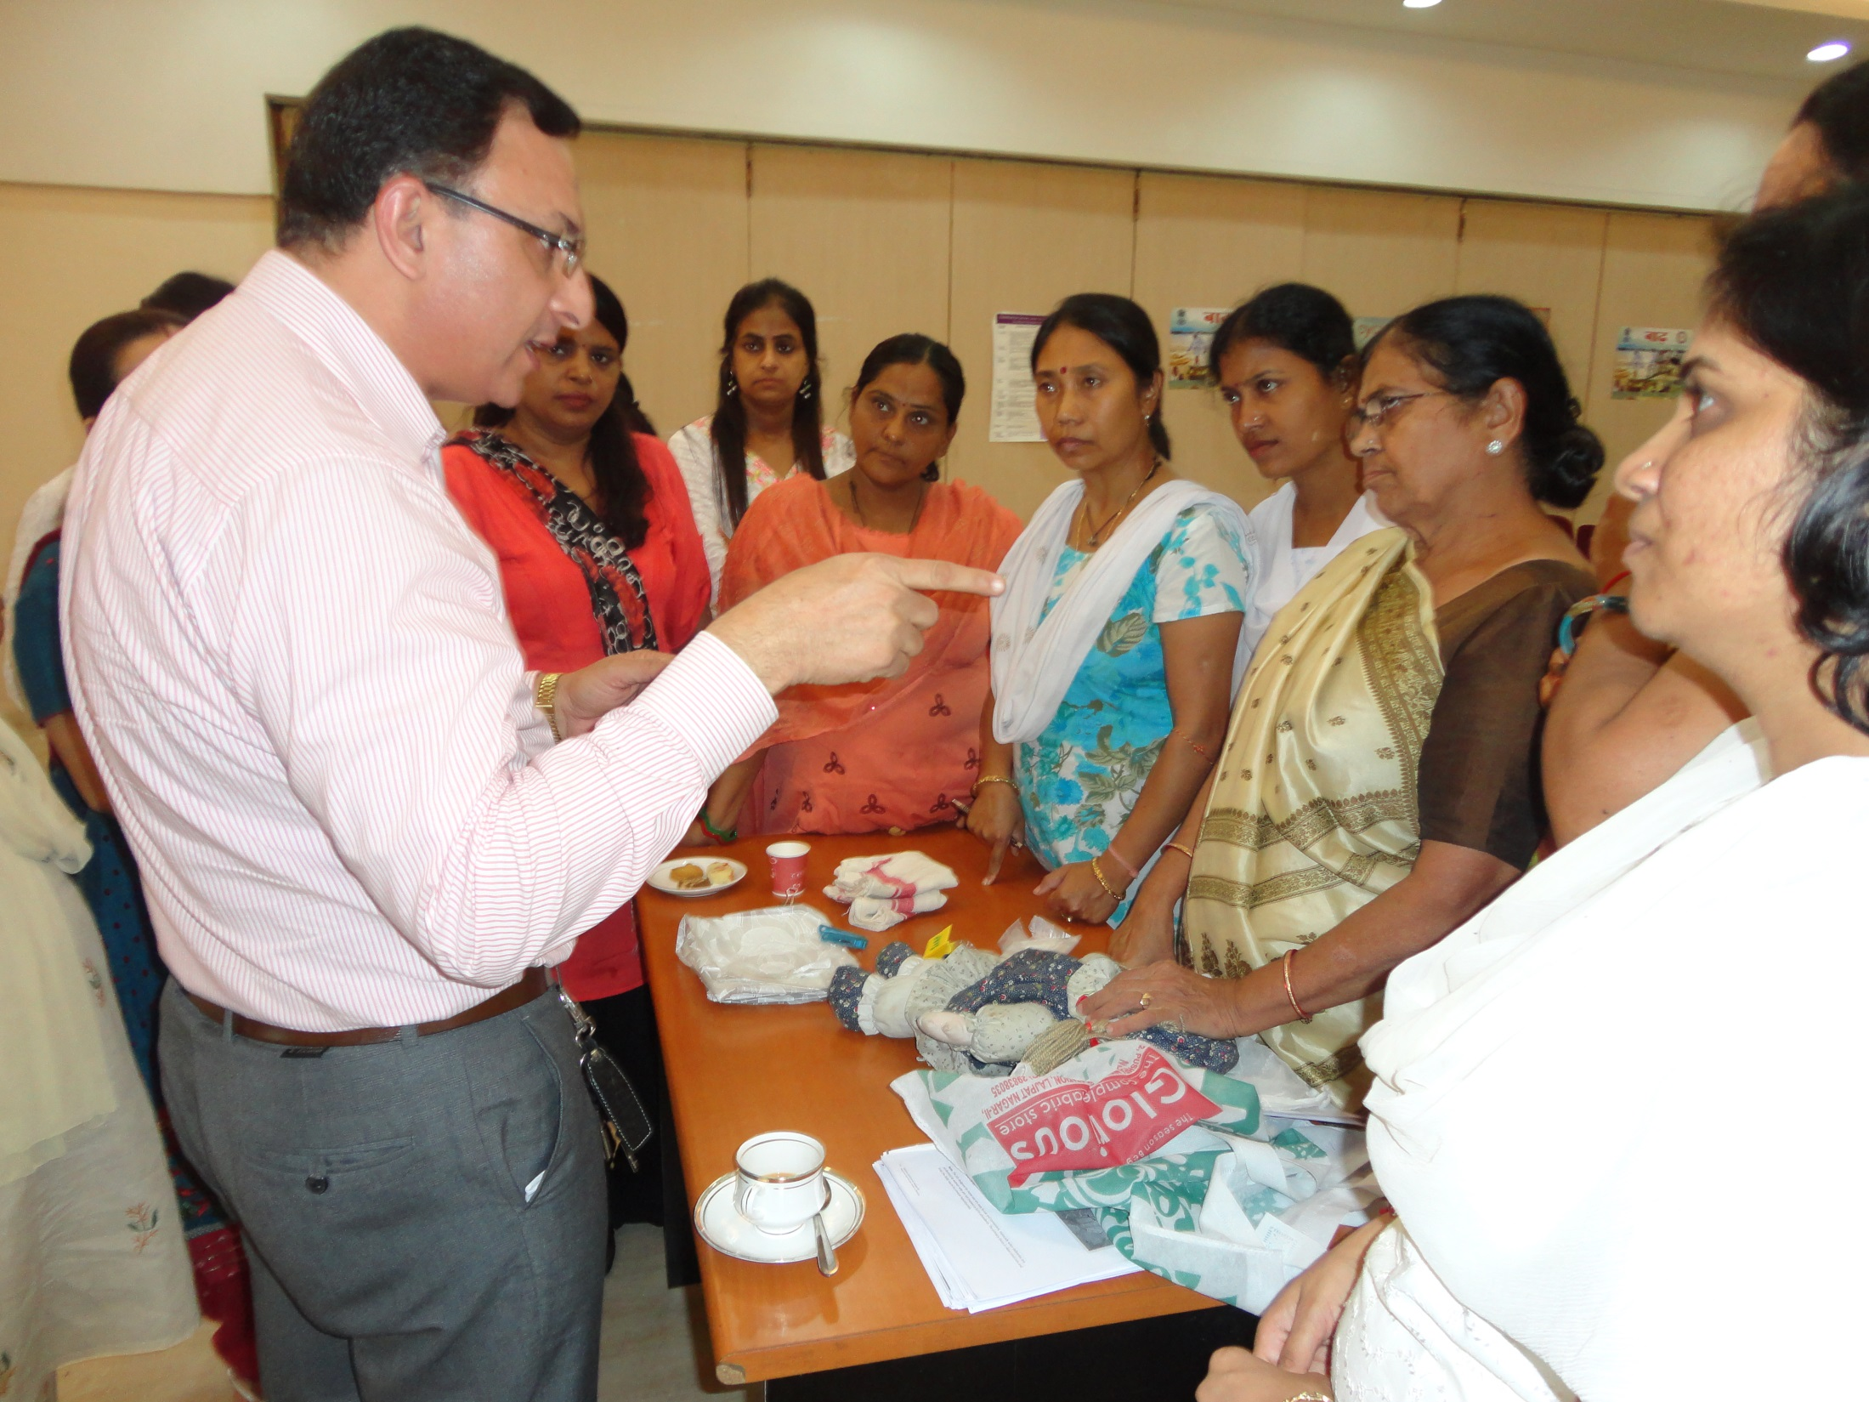

Slide 13
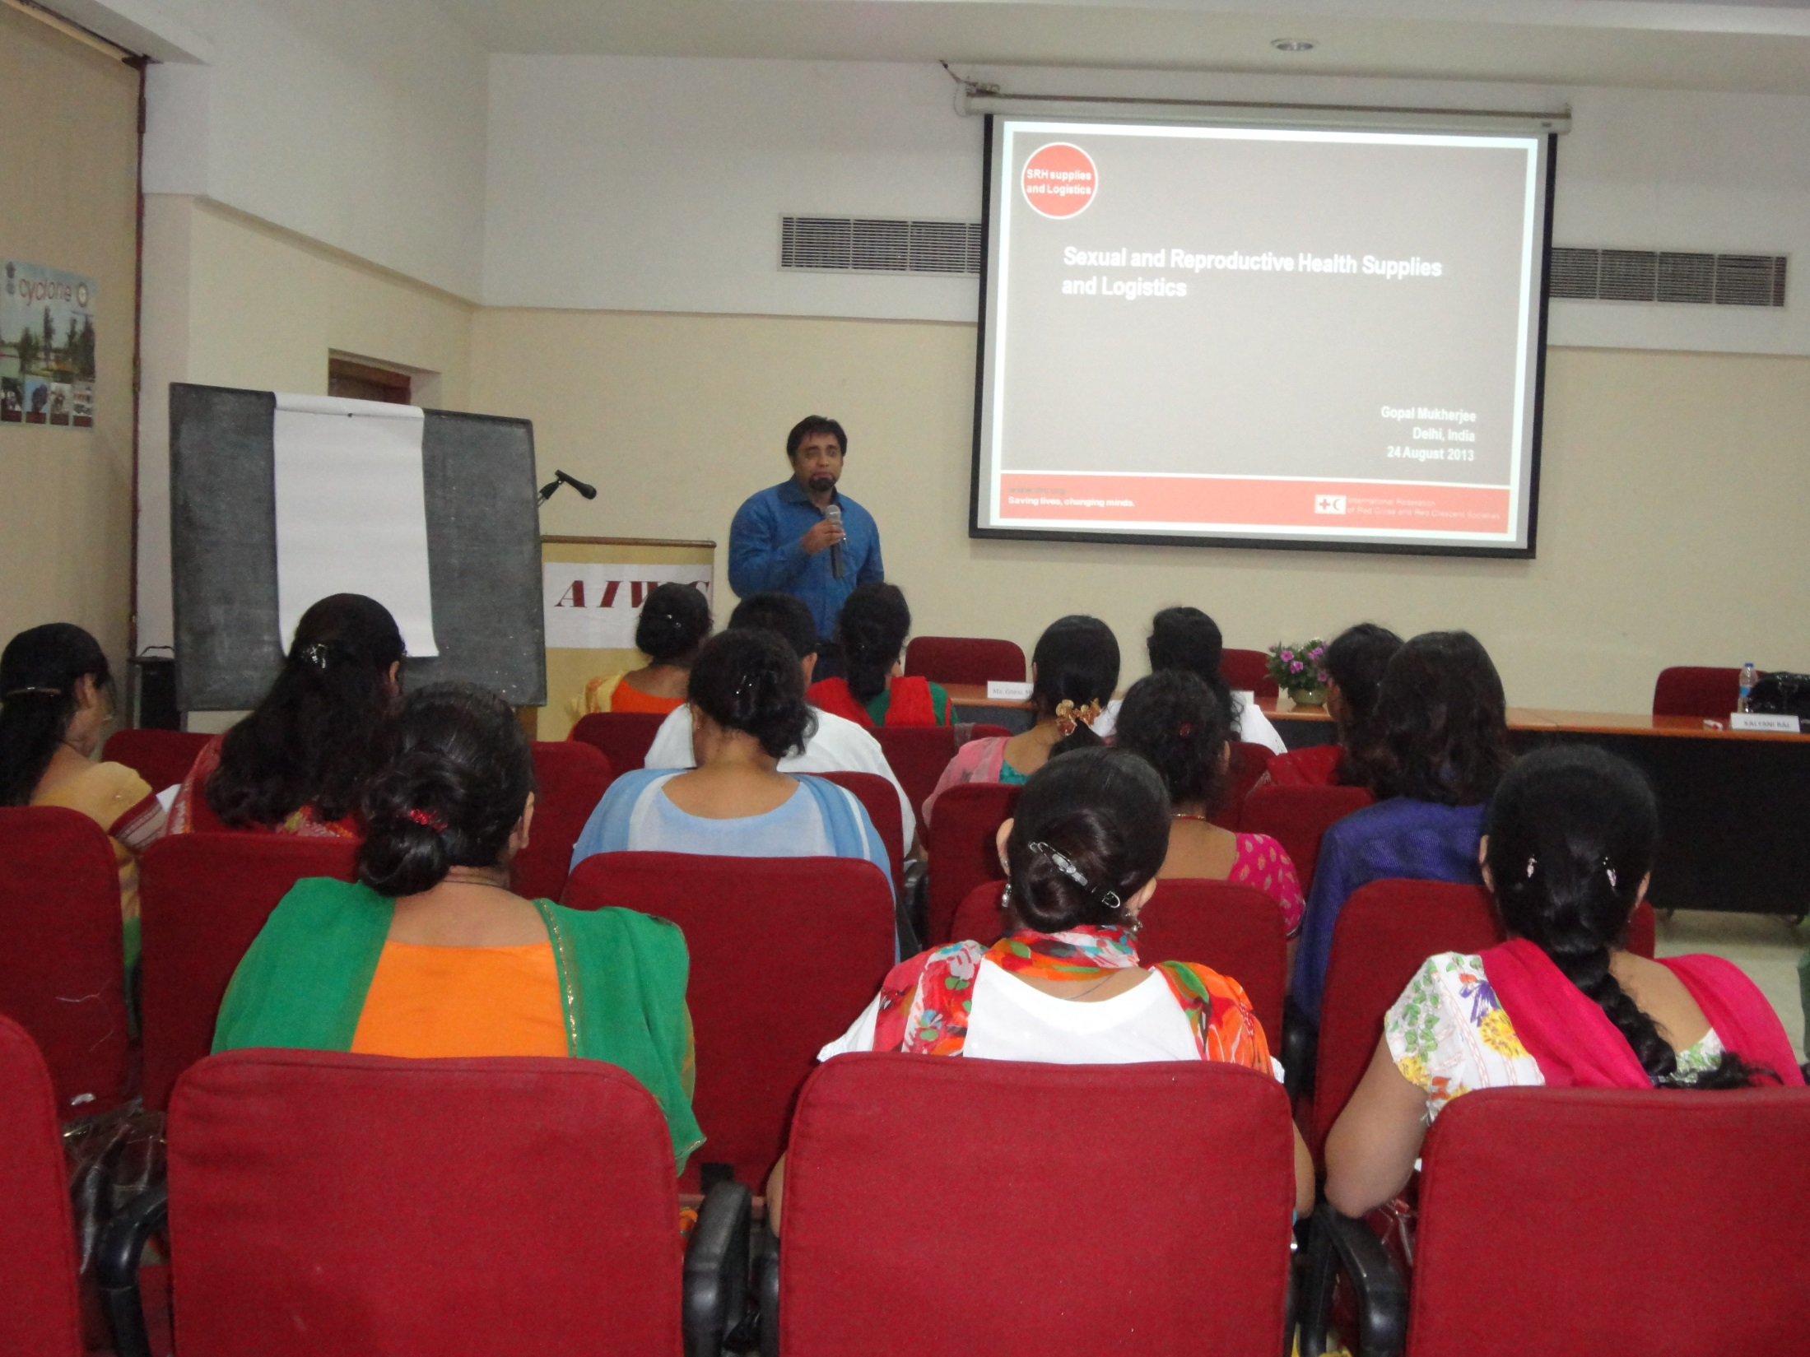

Slide 14
OUTCOME OF MISP TRAINING
Around 500 women benefitted from the initial training
Onward trainings by the Trainers in different regions
Members working on Community based DR plans
Better co-ordination with local agency

Slide 15
Thank you

